Slide 1
Malicious Servers and Browser Security

Slide 2
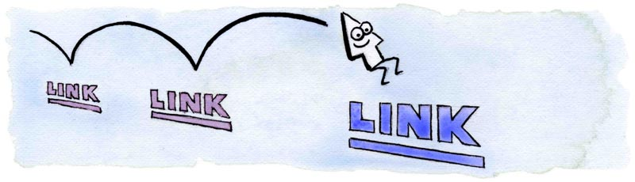
CSS History Probing
evil.com:
Client has visited Google, Facebook and the Facebook Group 12345
http://www.google.com
http://www.facebook.com
http://www.twitter.com
http://www.facebook.com/group?id=12345
http://www.facebook.com/group?id=98765
Client has NOT visited Twitter or Facebook Group 98765
Attacker uses JavaScript + CSS to check which links are visited
Image from http://matthewjamestaylor.com/blog/experimenting-with-visited-links

Slide 3
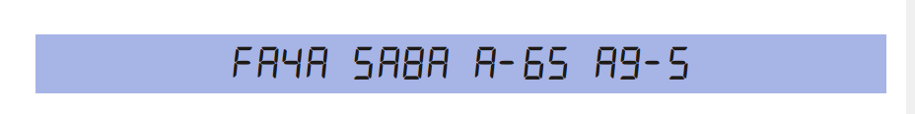
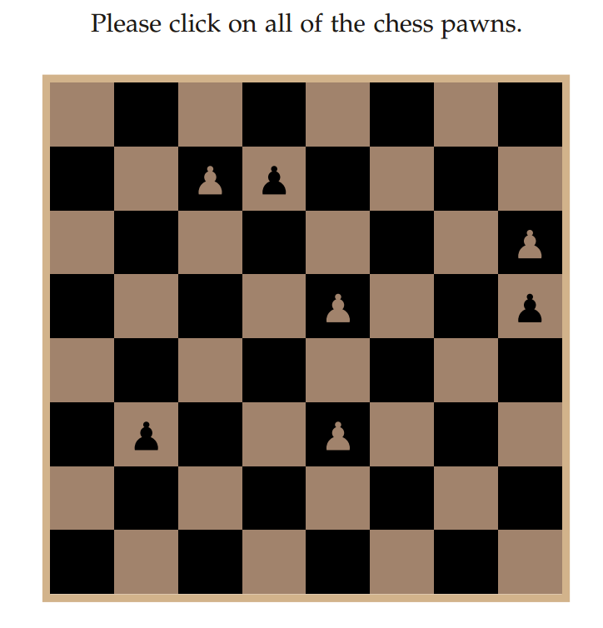
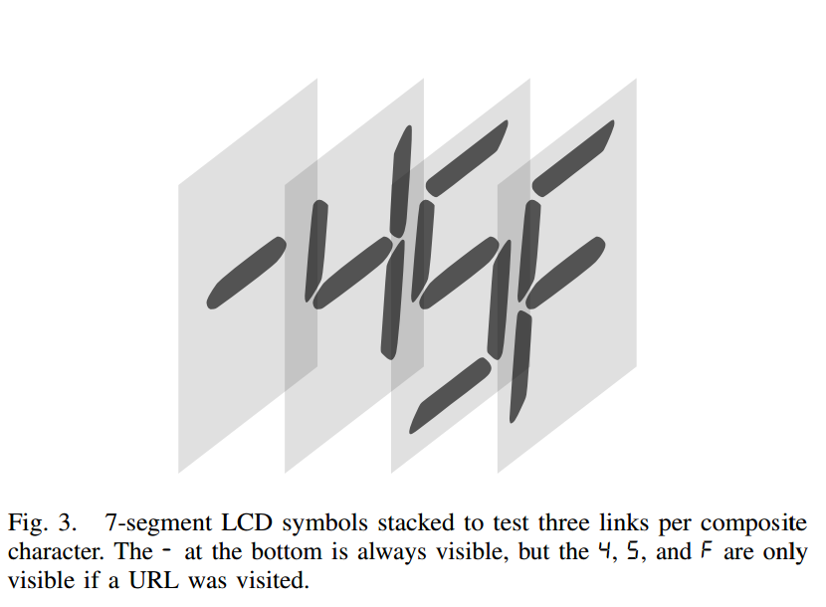
CSS History Probing
Work done at CMU!
Weinberg, Zachary, et al. "I still know what you visited last summer: Leaking browsing history via user interaction and side channel attacks." Security and Privacy (SP), 2011 IEEE Symposium on. IEEE, 2011.

Slide 4

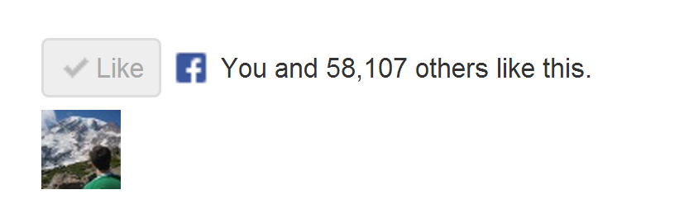
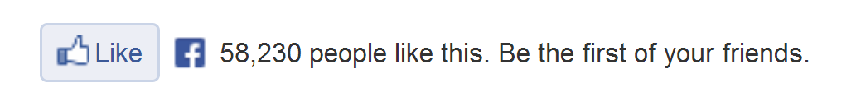
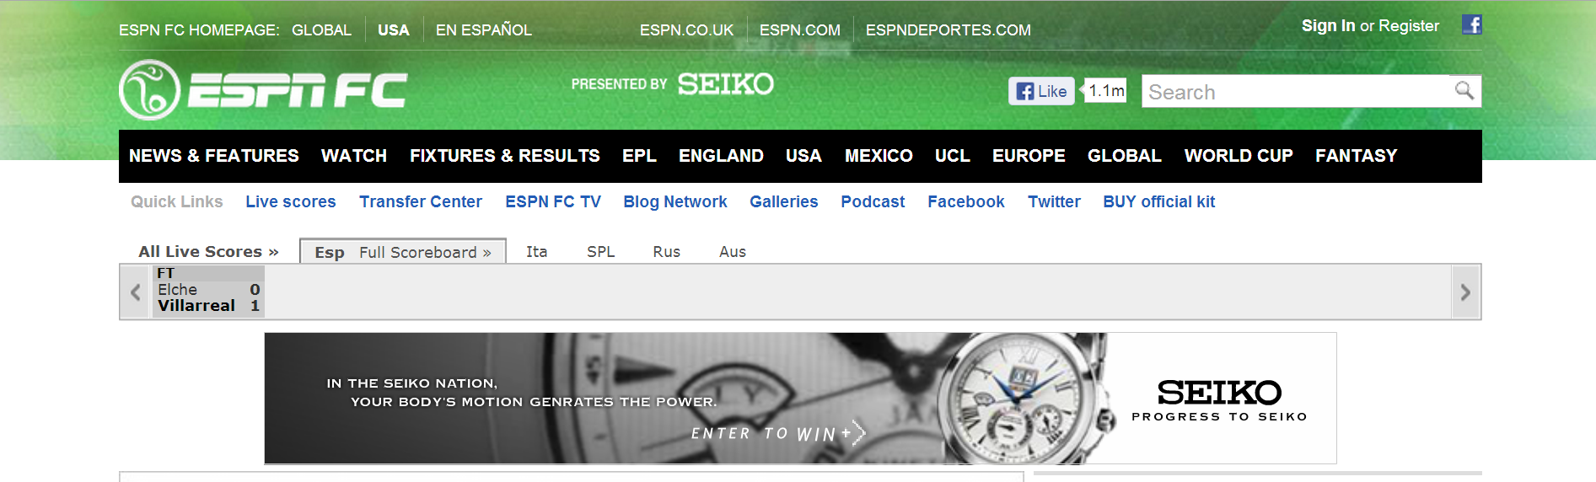
How does the “Like” button work?
Like button knows about your Facebook session!
Appears in “Mashup” with content from other domains

Slide 5
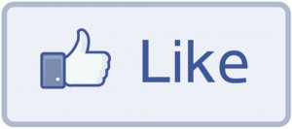
How does the “Like” button work?
Like Button Requirements:
Needs to access cookie for domain facebook.com
Can be deployed on domains other than facebook.com
Other scripts on the page should not be able to click Like button
We need to isolate the Like button from the rest of the page

Slide 6
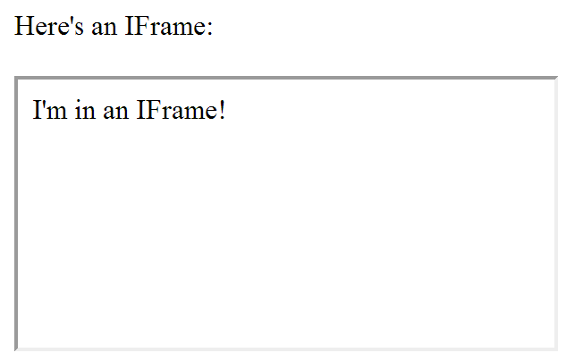
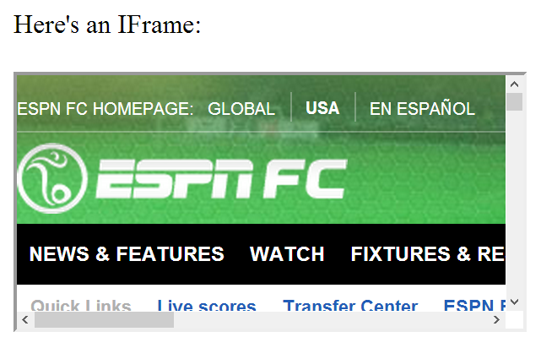
IFrames
Parent page
Embedded page
Any page can be embedded

Slide 7
IFrames
Pages share same domain
Pages do not share same domain
The same-origin policy states that the DOM from one domain should not be able to access the DOM from a different domain

Slide 8
How does the “Like” button work?
<iframe id="f5b9bb75c" name="f2f3fdd398" scrolling="no" title="Like this content on Facebook." class="fb_ltr" src="http://www.facebook.com/plugins/like.php?api_key=116656161708917..." style="border: none; overflow: hidden; height: 20px; width: 80px;"></iframe>
The same-origin policy prevents the host from clicking the button and from checking if it’s clicked

Slide 9
The same-origin policy prevents malicious sites from clicking their own “Like” button
What if the site can trick you into clicking it yourself?

Slide 10
Clickjacking
Clickjacking occurs when a malicious site tricks the user into clicking on some element on the page unintentionally.
Click for a FREE iPad!
Slides modeled after presentation by Lin-Shung Huang at USENIX 2012.
Paper: Lin-Shung Huang, Alex Moshchuk, Helen J. Wang, Stuart Schechter, and Collin Jackson. 2012. Clickjacking: attacks and defenses. In Proceedings of the 21st USENIX conference on Security symposium (Security'12). USENIX Association, Berkeley, CA, USA, 22-22.
Notes:
<a href="http://thenounproject.com/noun/cursor/#icon-No3065" target="_blank">Cursor</a> designed by <a href="http://thenounproject.com/fernando.yellow" target="_blank">Fernando Vasconcelos</a> from The Noun Project

Slide 11
Clickjacking
Click for a FREE iPad!
Real Cursor
Fake Cursor

Slide 12
Clickjacking
This is the button that gets clicked!
Click for a FREE iPad!
Real Cursor Hidden
Fake Cursor

Slide 13
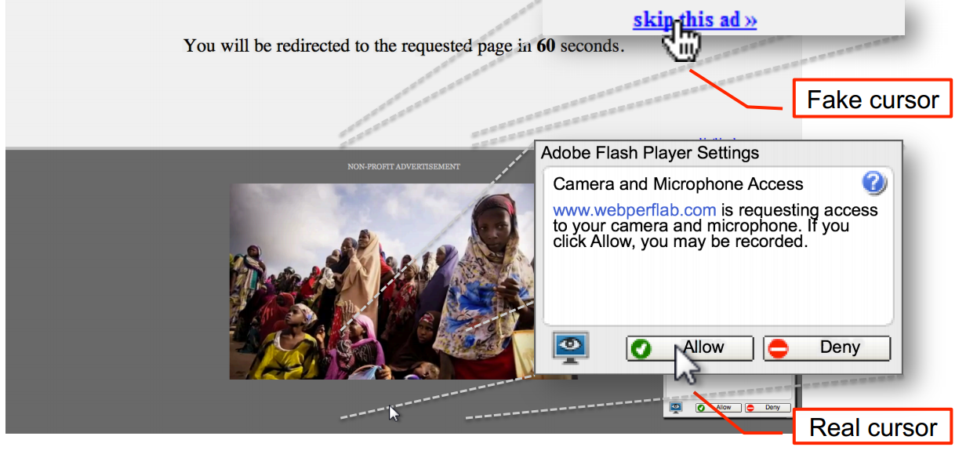
Advanced Clickjacking
Malicious site now has access to your webcam!
Also work done at CMU!
Lin-Shung Huang, Alex Moshchuk, Helen J. Wang, Stuart Schechter, and Collin Jackson. 2012. Clickjacking: attacks and defenses. In Proceedings of the 21st USENIX conference on Security symposium (Security'12). USENIX Association, Berkeley, CA, USA, 22-22.

Slide 14
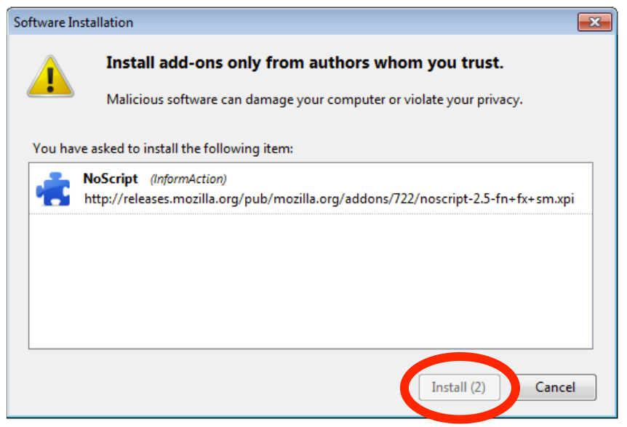
Clickjacking - Mitigation
Adding a delay between a button appearing and being usable helps prevent Clickjacking

Slide 15
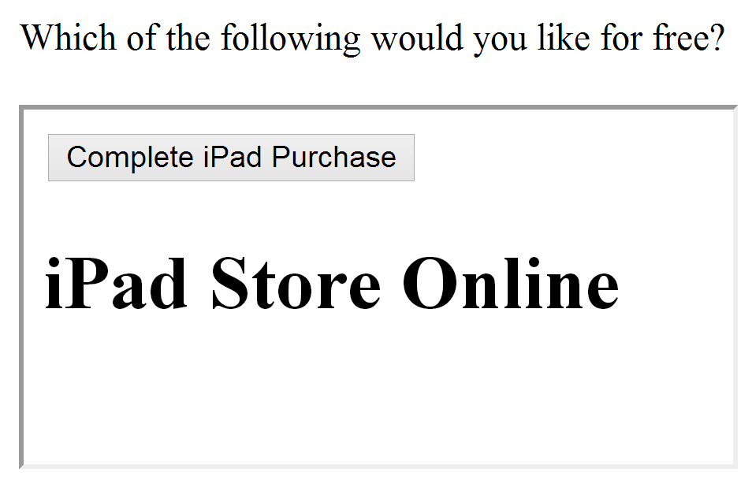
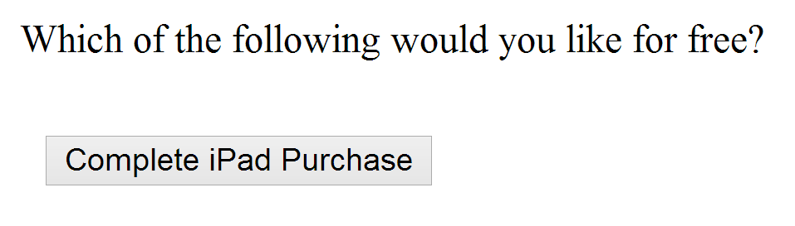
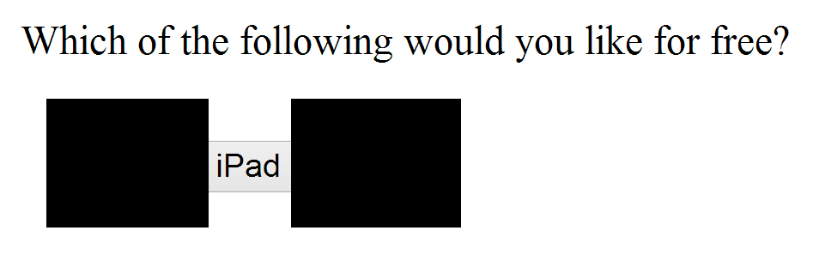
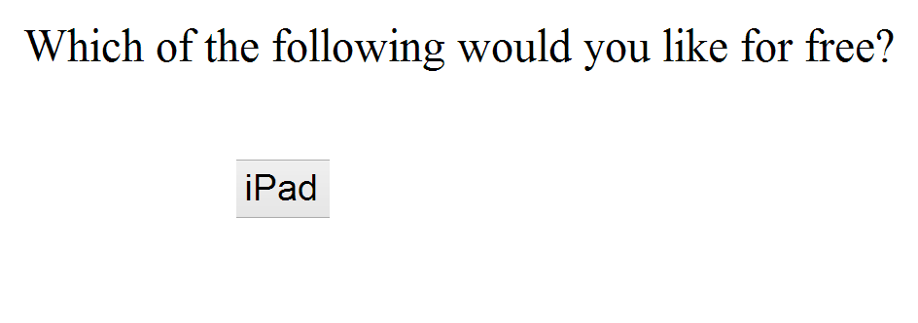
Using Frames for Evil
If pages with sensitive buttons can be put in an IFrame, then it may be possible to perform a Clickjacking attack

Slide 16
Framebusting
Framebusting is a technique where a page stops functioning when included in a frame.
<script type="text/javascript">
if(top != self) top.location.replace(self.location);
</script>
If the page with this script is embedded in a frame, then it will escape out of the frame and replace the embedding page
Notes:
http://beerpla.net/2009/10/29/modern-day-frame-busting-with-x-frame-options-and-this-content-cannot-be-displayed-in-a-frame-warnings/

Slide 17
Don’t roll your own crypto
Don’t write your own sanitization
Don’t write your own framebusting solution

Slide 18
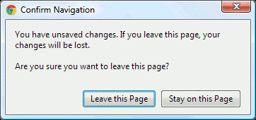
Framebusting is Complicated
if(top.location!=self.location) {
parent.location=self.location;
}
Fails if page is embedded two Iframes deep
<script type="text/javascript">
if(top != self) top.location.replace(self.location);
</script>
If the embedding page sets the onBeforeUnload event, the script can be blocked
If the embedding page makes lots of requests that return “204 – No Content” responses, we don’t even need the dialog
Rydstedt, Gustav, et al. "Busting frame busting: a study of clickjacking vulnerabilities at popular sites." IEEE Oakland Web 2 (2010).

Slide 19
Framebusting is Complicated
<style>
body { display: none; }
</style>
<script>
if (self == top) {
document.getElementsByTagName("body")[0]
.style.display = 'block';
} else {
top.location = self.location;
}
</script>
Does this work? Who Knows?
Javascript-based Framebusting is a just a hack.
Is there a better way?
Rydstedt, Gustav, et al. "Busting frame busting: a study of clickjacking vulnerabilities at popular sites." IEEE Oakland Web 2 (2010).

Slide 20
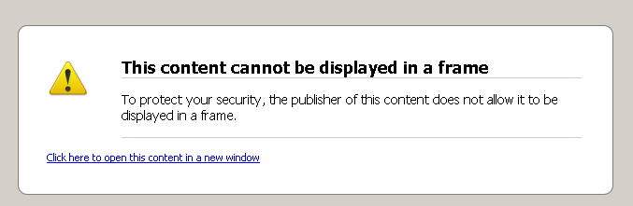
X-Frame-Options Header
  DENY:
  The page cannot be embedded in a frame
  SAMEORIGIN:
  The page can only be framed on a page with the same domain
  ALLOW-FROM origin:
  The page can only be framed on a page with a specific other domain
Can limit flexibility and might not work on older browsers
Notes:
http://beerpla.net/2009/10/29/modern-day-frame-busting-with-x-frame-options-and-this-content-cannot-be-displayed-in-a-frame-warnings/

Slide 21
Multi-Party Web Applications

Slide 22
Party A
Party B
Same-origin policy won’t stop parties from communicating directly to share information
This can be good:
Single Sign-On
Multiparty E-Commerce
Client

Slide 23
Disclaimer: The exact details of the following protocols may not be 100% correct (i.e. Facebook might use a slightly different implementation than presented here). Our goal is to get a feel for how these systems work.
This section won’t be on the test. Something similar may come up in the homework, however.

Slide 24

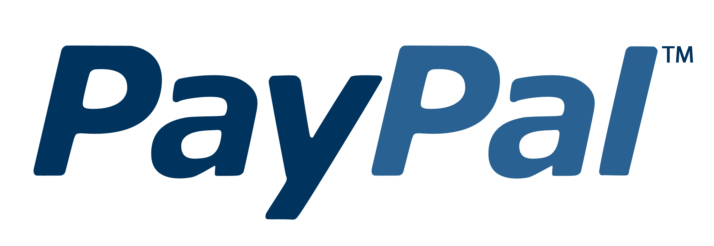
Multi-Party E-Commerce Applications
Order 123 is completed
I’d like the $40 Vest
/pay?id=123&total=40
Give me $40
Shipping you
your vest
Here’s my $40
Redirect to
paypal.com/pay
?id=123&total=40
Cool
Client
Wang, Rui, et al. "How to shop for free online--Security analysis of cashier-as-a-service based Web stores." Security and Privacy (SP), 2011 IEEE Symposium on. IEEE, 2011.
Notes:
http://techonomy.com/wp-content/uploads/2013/06/paypal_logo.jpg

Slide 25
Multi-Party E-Commerce Applications
Order 123 is completed
I’d like the $40 Vest
/pay?id=123&total=1
Give me $1
Shipping you
your vest
Here’s my $1
Redirect to
paypal.com/pay
?id=123&total=40
Cool
Client
Wang, Rui, et al. "How to shop for free online--Security analysis of cashier-as-a-service based Web stores." Security and Privacy (SP), 2011 IEEE Symposium on. IEEE, 2011.
Notes:
http://techonomy.com/wp-content/uploads/2013/06/paypal_logo.jpg

Slide 26
Multi-Party E-Commerce Applications
$40
Signature checks out.
Sending you your vest.
Redirect to
paypal.com/pay:
id=123
total=40
callback = jimmy.com
Signed by Jimmy
I’d like the $40 Vest
Redirect to
paypal.com/pay:
id=123
total=40
callback = jimmy.com
Signed by Jimmy
Give me $40
paypal.com/pay:
total=40
Signed by PayPal
Here’s my $40
Redirect to jimmy.com
total = 40
Paid
Signed by PayPal
Client
Wang, Rui, et al. "How to shop for free online--Security analysis of cashier-as-a-service based Web stores." Security and Privacy (SP), 2011 IEEE Symposium on. IEEE, 2011.
Notes:
http://techonomy.com/wp-content/uploads/2013/06/paypal_logo.jpg

Slide 27
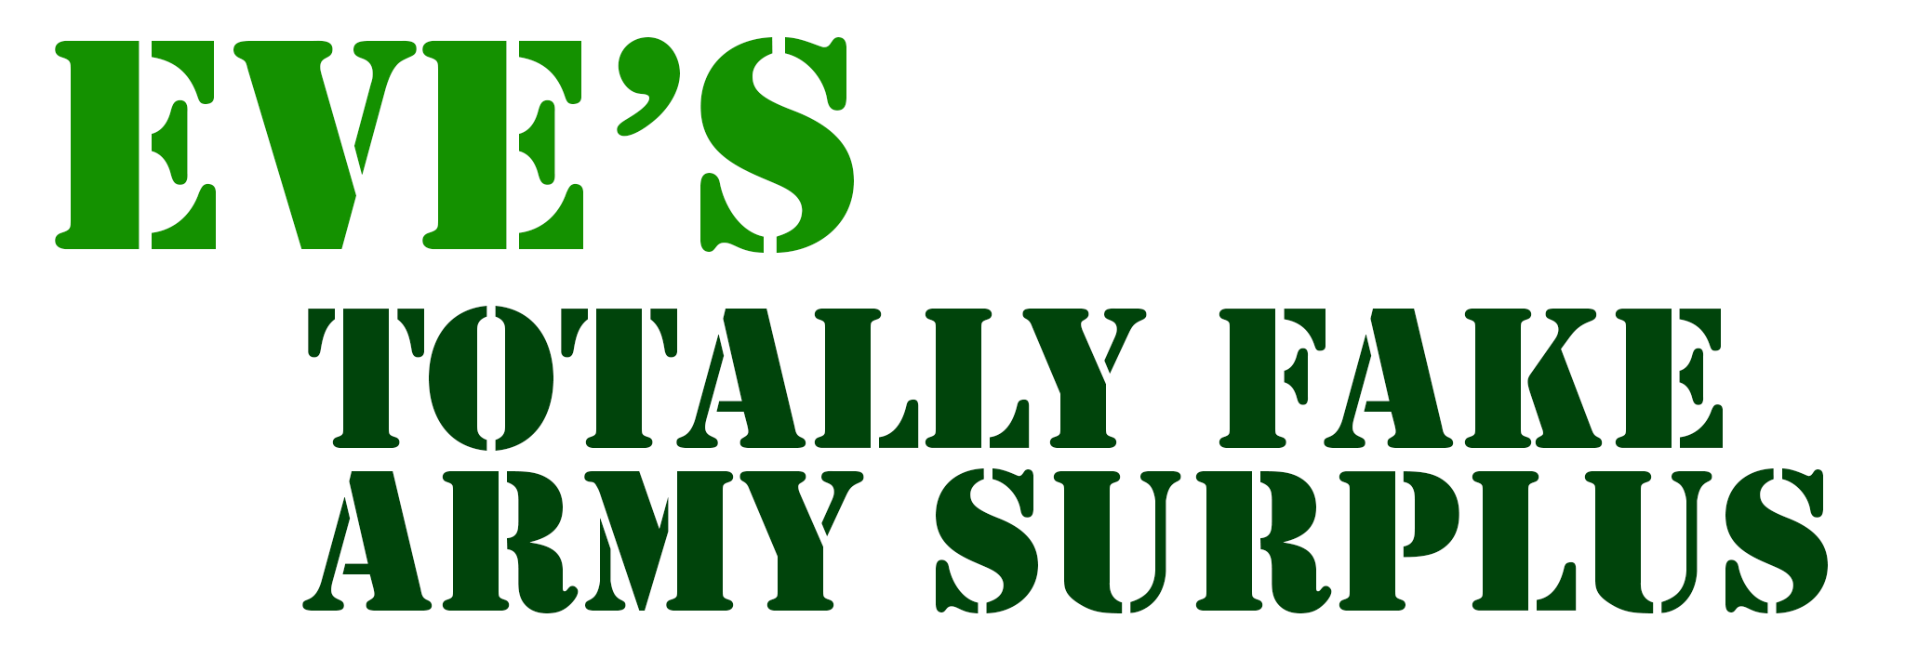
Multi-Party E-Commerce Applications
Eve makes
store linked
to PayPal
$40
Signature checks out.
Sending you your vest.
Redirect to
paypal.com/pay:
id=123
total=40
callback = jimmy.com
Signed by Eve’s Store
I’d like the $40 Vest
Redirect to
paypal.com/pay:
id=123
total=40
callback = jimmy.com
Signed by Jimmy
Give me $40
paypal.com/pay:
total=40
Signed by PayPal
Here’s my $40
Redirect to jimmy.com
total = 40
Paid
Signed by PayPal
Eve
Wang, Rui, et al. "How to shop for free online--Security analysis of cashier-as-a-service based Web stores." Security and Privacy (SP), 2011 IEEE Symposium on. IEEE, 2011.
Notes:
http://techonomy.com/wp-content/uploads/2013/06/paypal_logo.jpg

Slide 28
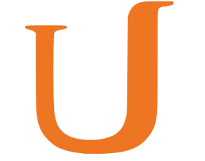

Single Sign-On: OAuth
Z linked to Alice’s session
Knows Udacity’s
secret is Y
Z is authenticated as Alice
Facebook secret: Y
Who has token “X”? My secret is Y
It’s Alice. She has 5 friends.
Redirect to Facebook
(include callback URL)
and identifier Z
Z, callback
Give your permission
to Udacity?
I’d like to sign in
with Facebook
Yeah
Here’s the token “X”
for user Z
OK. Here’s a special token “X”. Redirect to callback with identifier Z
Alice
OAuth Security Advisory: 2009.1
Notes:
http://www.underconsideration.com/brandnew/archives/facebooks_radically_new_f_logo.php

Slide 29
Single Sign-On: OAuth
Z linked to Eve’s session
Knows Udacity’s
secret is Y
Eve is authenticated as Alice
Facebook secret: Y
Who has token “X”? My secret is Y
It’s Alice. She has 5 friends.
Type of Session Fixation Attack – Fixed in OAuth 2.0
Here’s the token “X”
for user Z
Z, callback
I’d like to
sign in with
Facebook
Redirect to Facebook
(include callback URL)
and identifier Z
Give your permission
to Udacity?
Huh? Whatever
OK. Here’s a special token “X”. Redirect to callback with identifier Z
Hey Alice!
Check out
this URL!
Eve
Alice
OAuth Security Advisory: 2009.1
Notes:
http://www.underconsideration.com/brandnew/archives/facebooks_radically_new_f_logo.php

